Slide 1
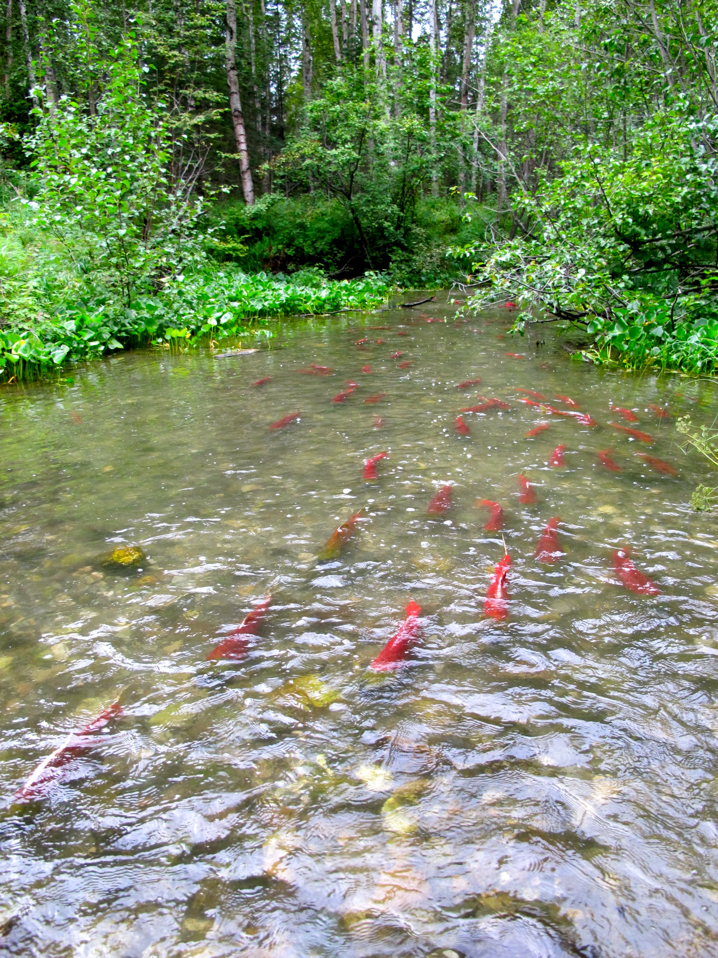
Matanuska-Susitna Basin Salmon Habitat Partnership
Mat-Su Basin Salmon Habitat Partnership
Red plane photo from brochure cover
Jessica Speed, Mat-Su Salmon Habitat Partnership
February 9th, 2016 ~ All Alaska Fish Habitat Partnership Meeting
Anchorage, Alaska
Notes:
Slide 1: (25 sec)
My name is Jessica Speed, I’m coordinator of the MSBasin SHP, and employed by the Nature Conservancy. So I’m going to share with you a bit about the partnership, some collective progress working toward strategic goals in the last 2 years, well as touching on efforts going forward.

Slide 2
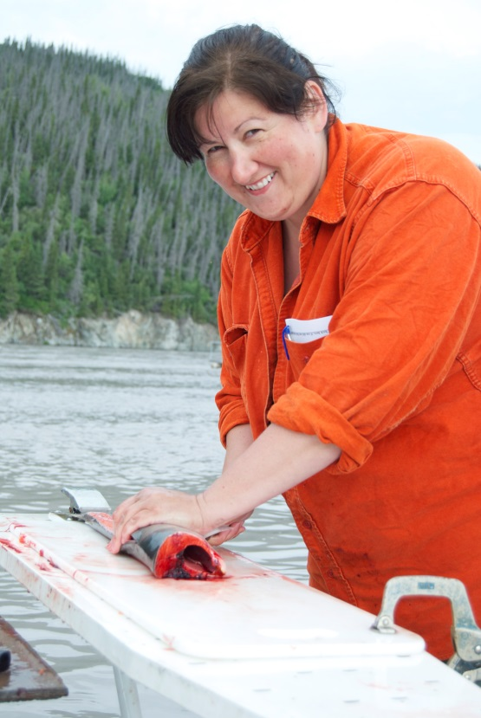
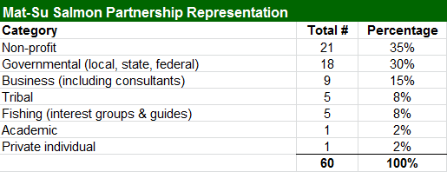
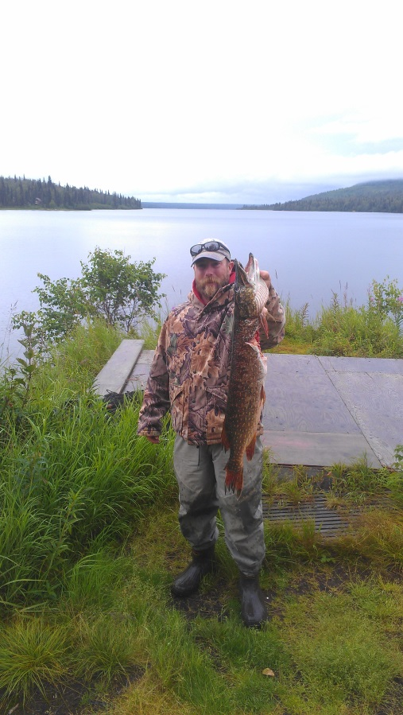
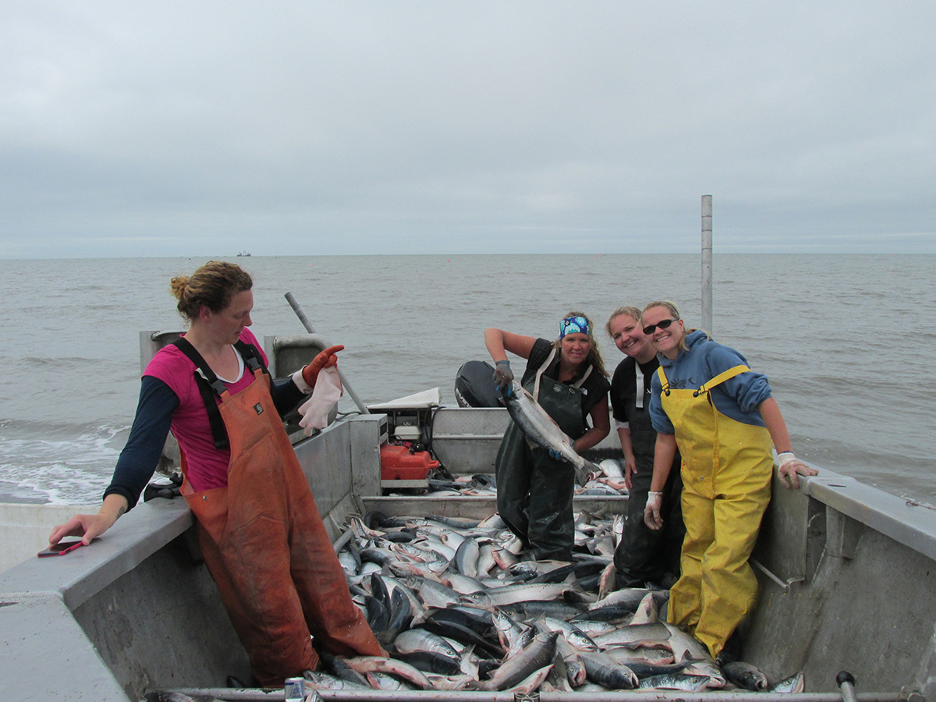
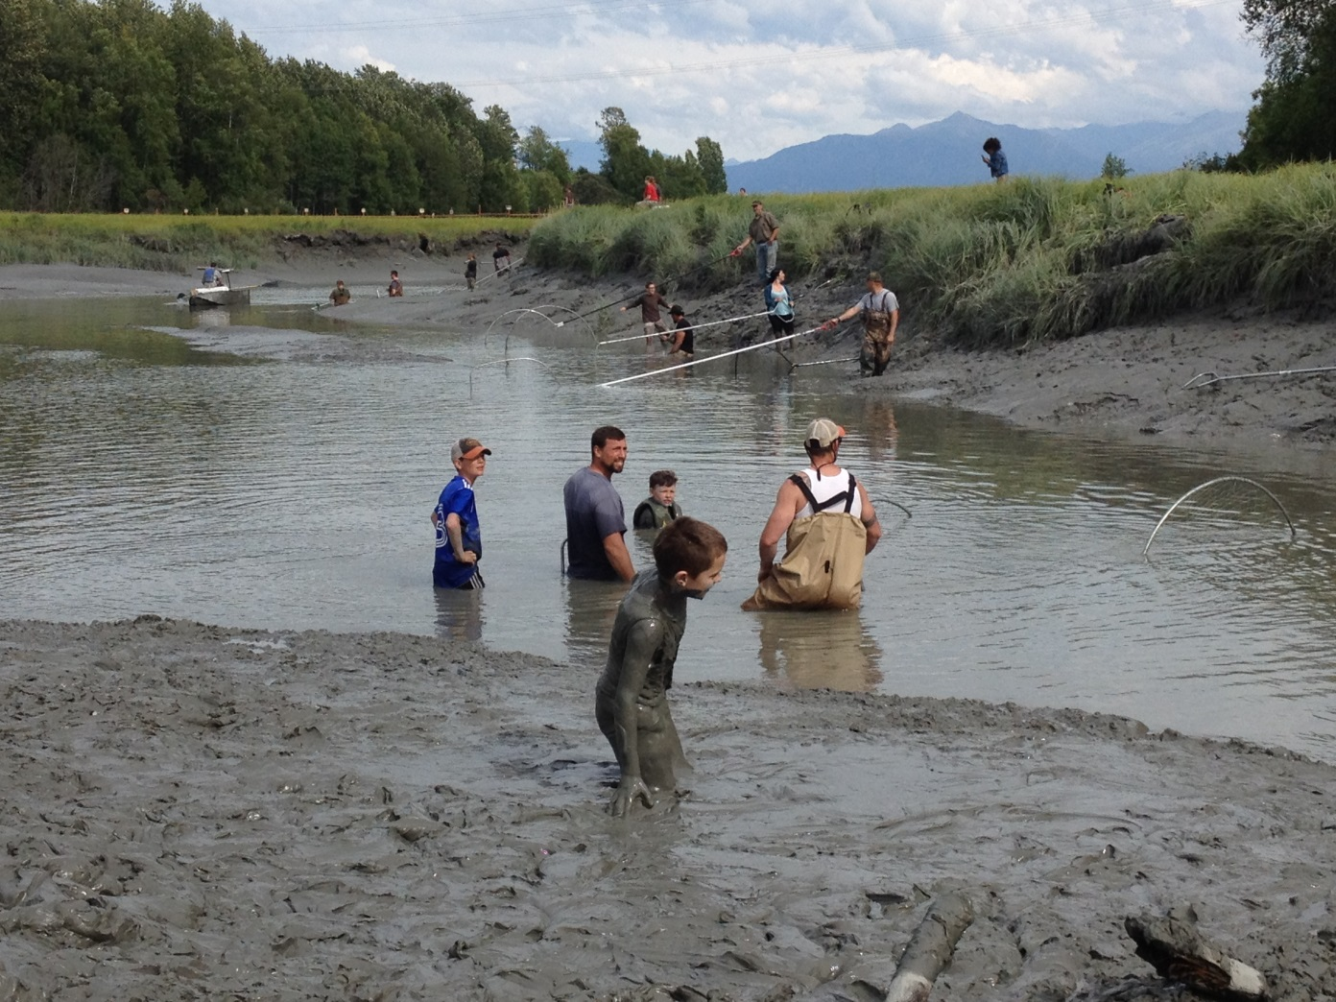
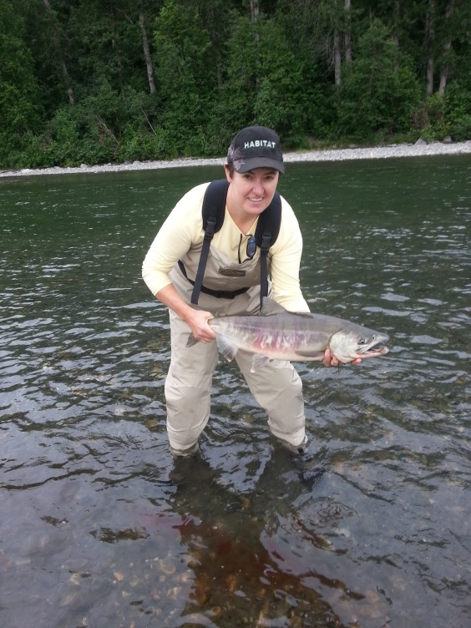
Thriving Fish, Healthy Habitats & Vibrant Communities Can Co-exist in the Mat-Su
Together the
Matanuska & Susitna watersheds total over 25,000 square miles
Notes:
Slide 2: (45 sec)
Who is the FHP?
The partnership formed in 2005 to address increasing impacts on salmon habitat from human use and development, and we’re now a coalition of 61 diverse orgs. (Nearly everyone in this room is with a partner organization – and in many cases founding orgs. We also have several steering committee members here.

Slide 3
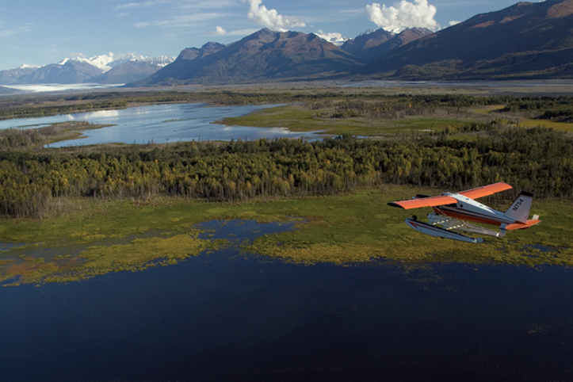
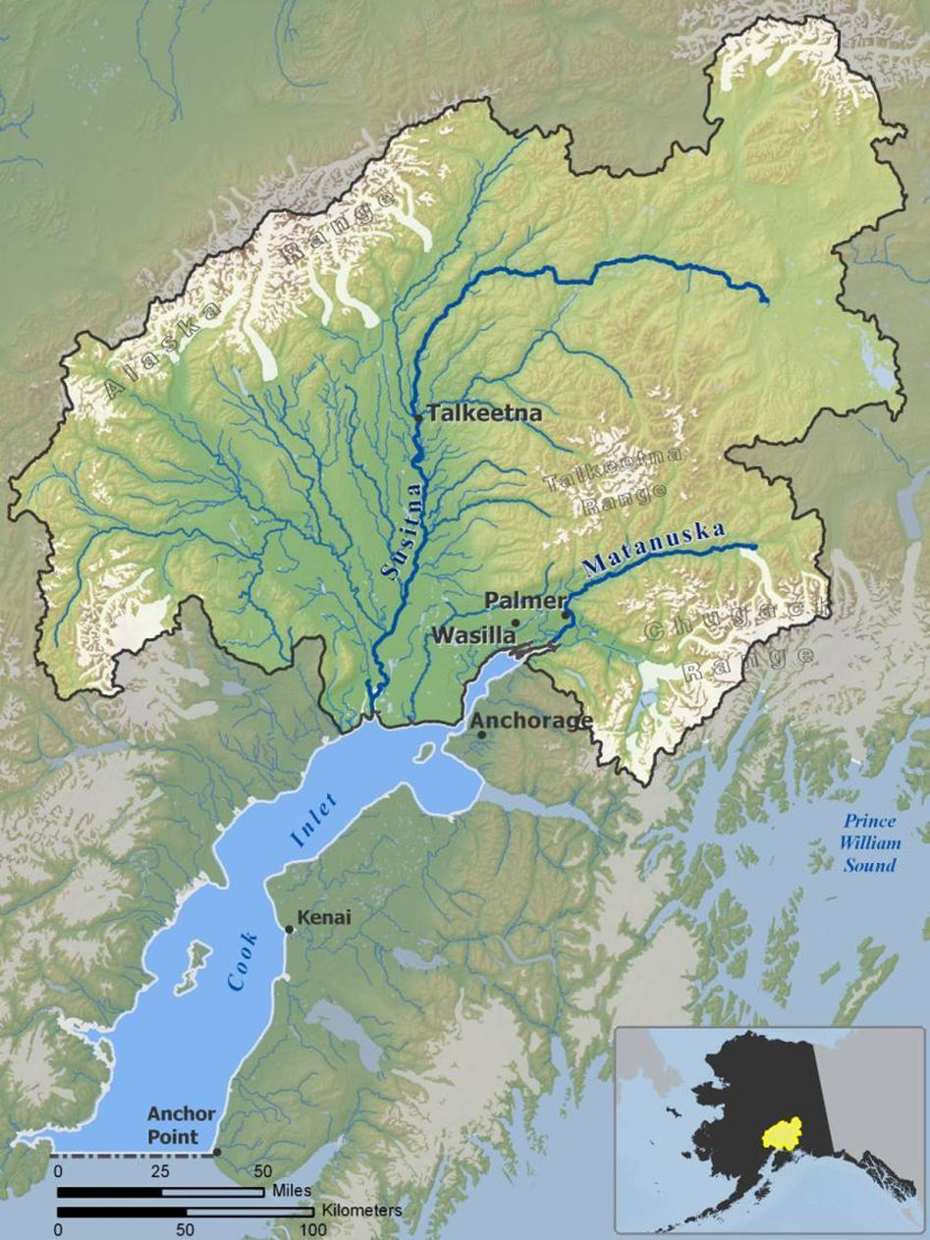
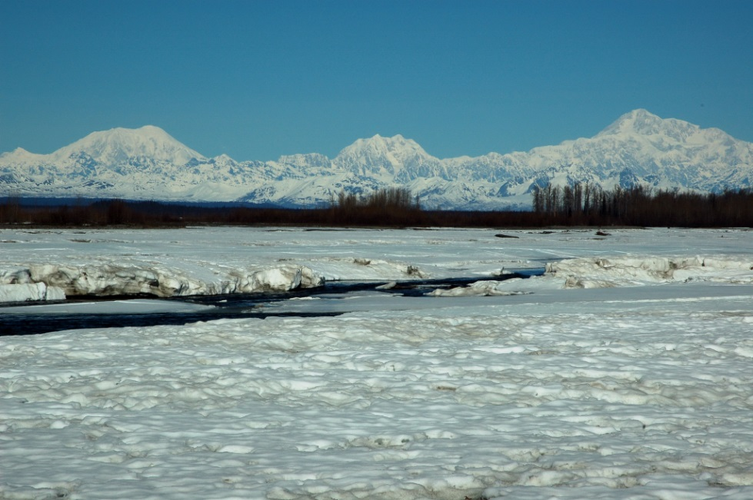
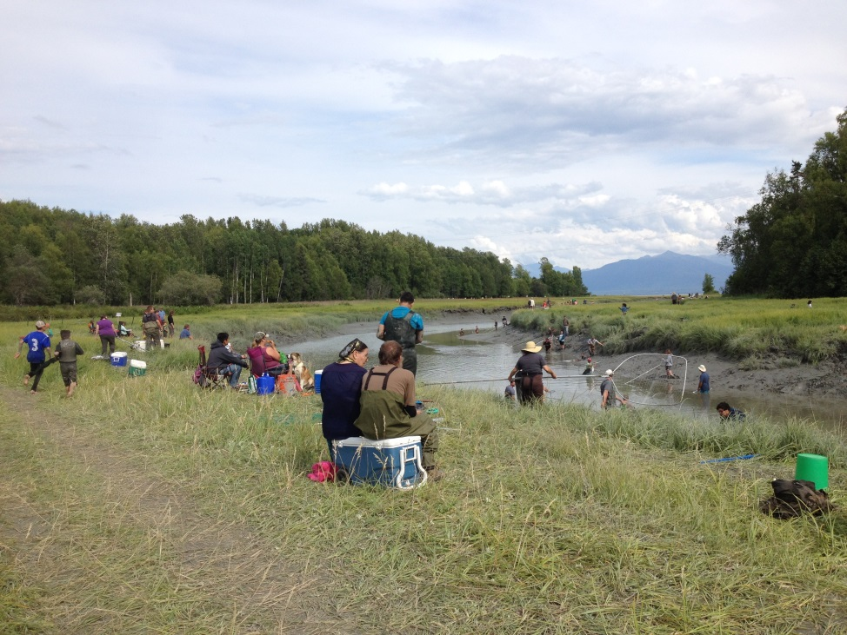
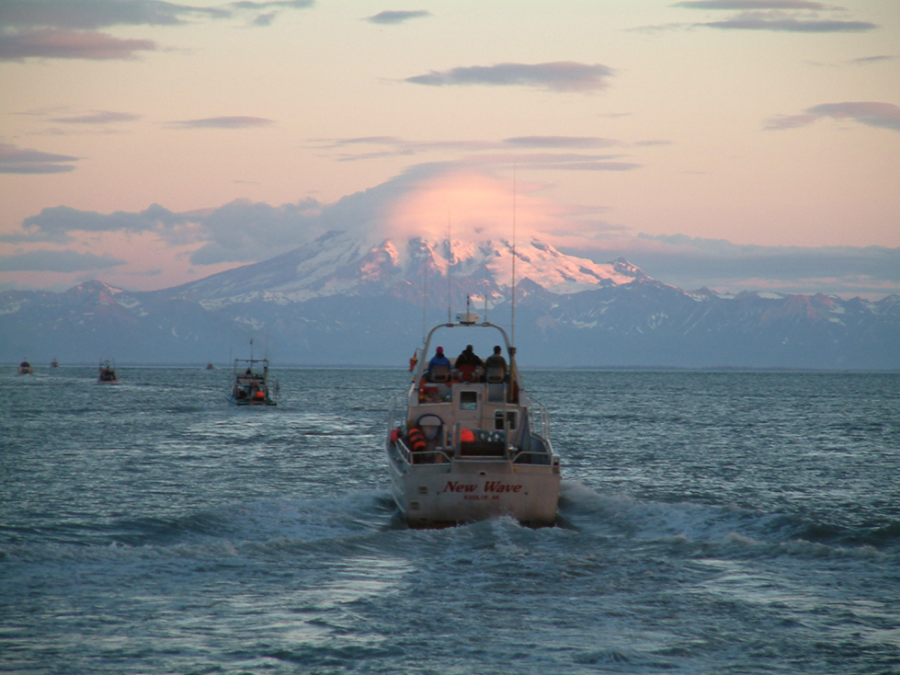
Together the
Matanuska & Susitna watersheds total over 25,000 square miles
Together the
Matanuska & Susitna watersheds total over 25,000 square miles
Geographic area: Matanuska and Susitna watersheds
Notes:
Slide 3: - what do we do?
Our strategic plan identifies 12 primary potential threats to salmon habitat in the Mat-Su Basin, and conservation strategies to address them.
Partners conserve healthy habitat that exists, restore degraded habitat, and work to improve our knowledge about salmon and their habitats. The Partnership also provides a forum for education, information exchange and collaboration.
Since 2006, 72 salmon habitat related projects in the Mat-Su have been funded with nearly 2 million dollars with millions more in match and leverage through the National Fish Habitat Partnership program.
17 projects were funded in the last 2 years.

Slide 4
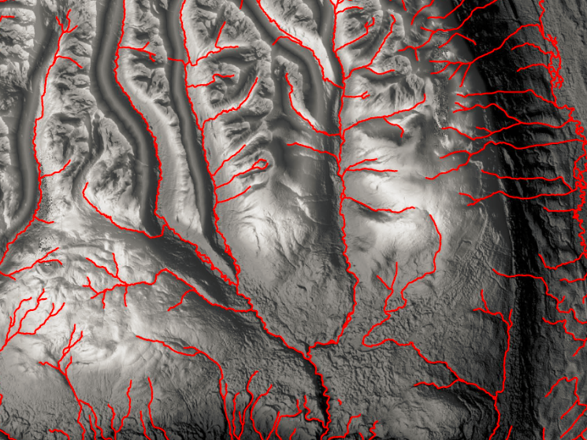
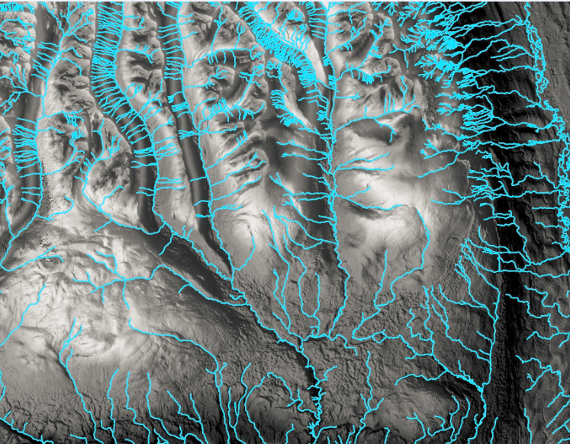
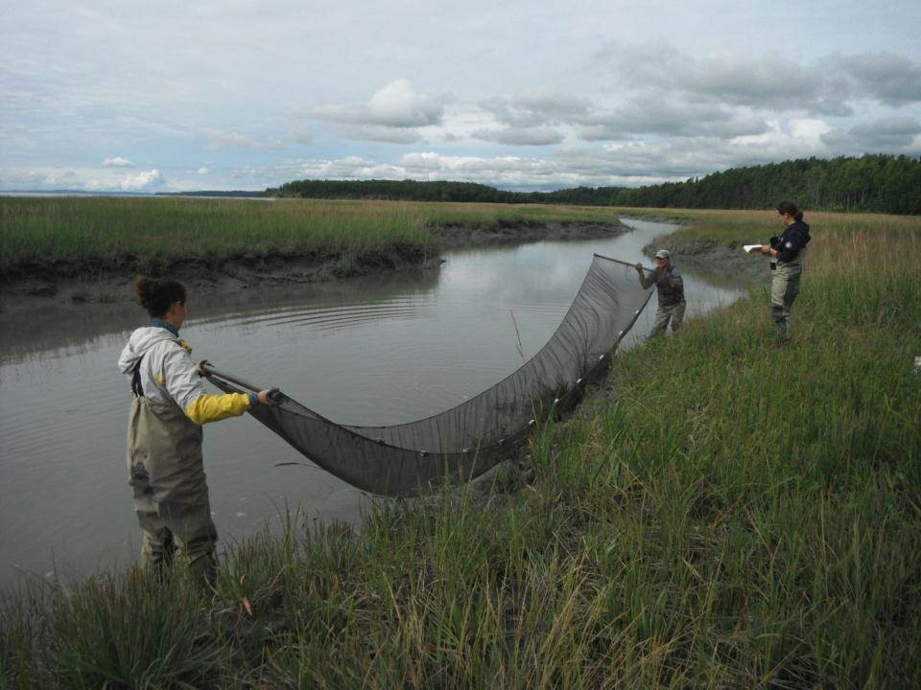
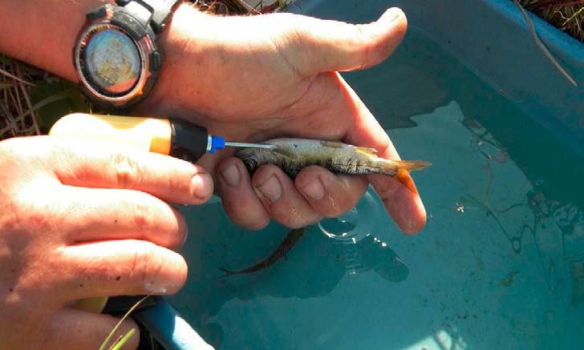
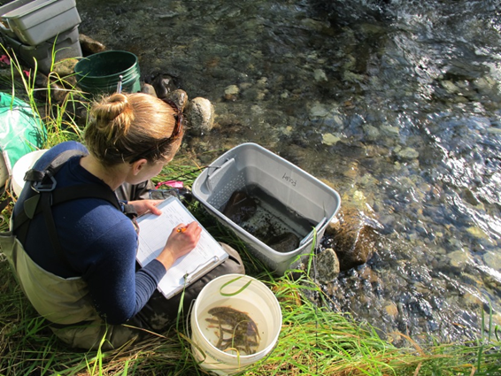
Partnership Progress ~ Science:
Mapping streams to national standards
Improvements in knowledge of salmon
Identification of cold water refugia
Notes:
Slide 4 - In the Mat-Su like much of Alaska we are still lacking in some of the basic foundational science. Filling in those gaps has been a priority - we've made some great strides:
Stream mapping - Two months ago TNC, and partners completed an update to the USGS National Hydrographic Database. This doubled the number of mapped streams in the basin, increased the accuracy of stream maps and brought them up to national standards.
Increasing knowledge of salmon - Partners have increased our knowledge of juvenile salmon distribution, abundance and important overwintering areas across the basin. As an example, FWS research in Big Lk drainage found that juvenile coho salmon have just a handful of key overwintering areas. That information is helping prioritize fish passage improvements to ensure Big Lk salmon have access to key areas needed throughout their lifecycle.
long term stream temperature monitoring - CIK and partners have created a network of stream temp monitoring sites. These are being used to identify cold water refugia - areas that will remain coolest in a warming climate and therefore important to resiliency of salmon. This knowledge is directly informing land trusts in conserving important lands today and into the future.

Slide 5
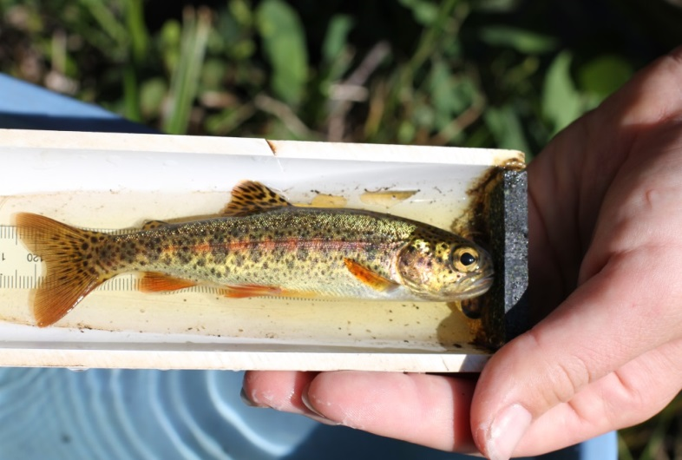
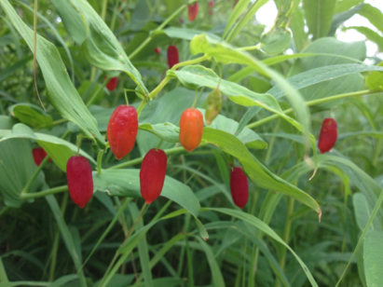
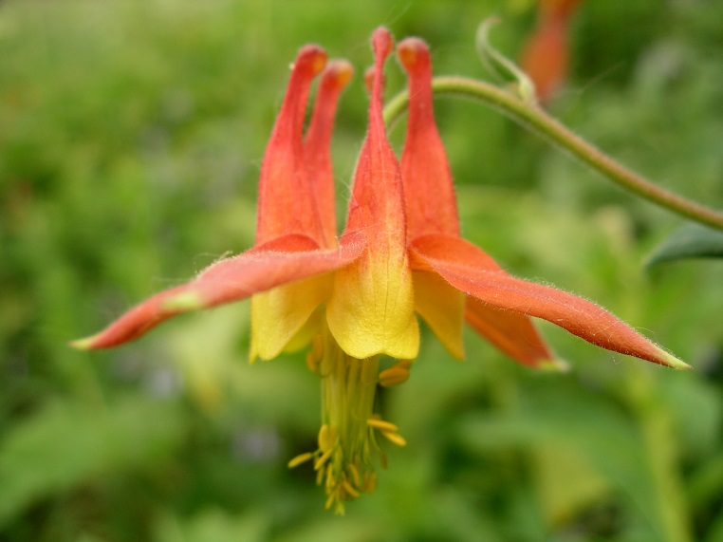
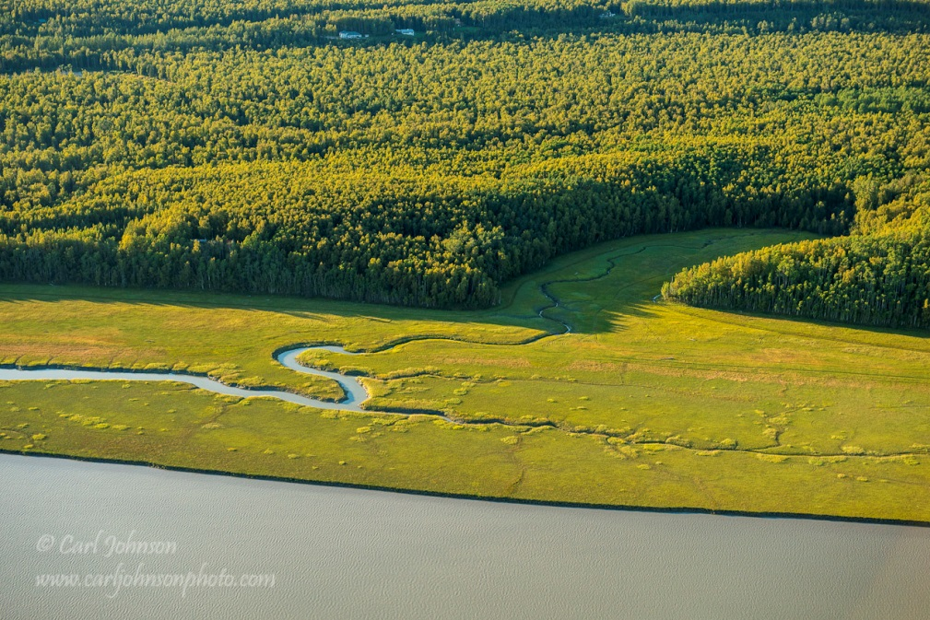
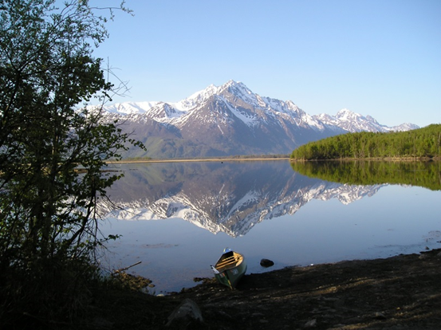
aldjfkdfjldfkjldkf
Partnership Progress ~ Conservation:
1,000 acres of important salmon habitat conserved
Water reservations filed for Moose Creek & data collected on Kashwitna River and Little Willow Creek
84 stream miles & 6 streams added to the Anadromous Waters Catalog
Notes:
Slide 5: Conservation (1 min)
Unlike our FHP counterparts in the lower 48, we still have intact salmon habitat, and our top priority is to conserve it.
Important salmon habitat Conserved
Through conservation easements Great Land Trust and partners have protected nearly 1,000 acres of priority salmon habitat.
Conserving Water Quantity
Applications for water reservations have focused on covering the most populated 'core area' (palmer-wasilla-knik, then willow to talkeetna up the parks highway) and should be complete by 2017. USGS, FWS and ADF&G have already begun efforts to identify the next set of priority streams for gaging.
Stream Protection:
84 stream miles and 6 streams were added in the last two years to the Anadromous Waters Catalog. This contributes information about salmon distribution and gives streams protection under state law. Currently less than 20% of the miles of mapped streams in Mat-Su are in the catalog.

Slide 6
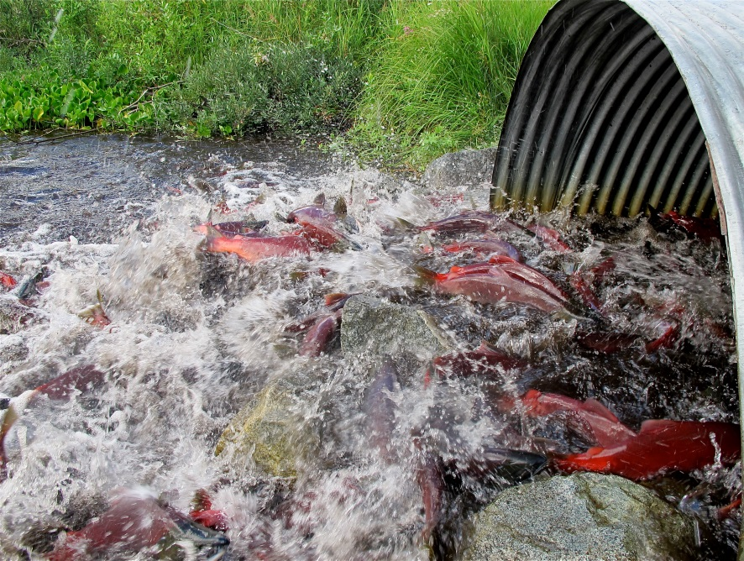
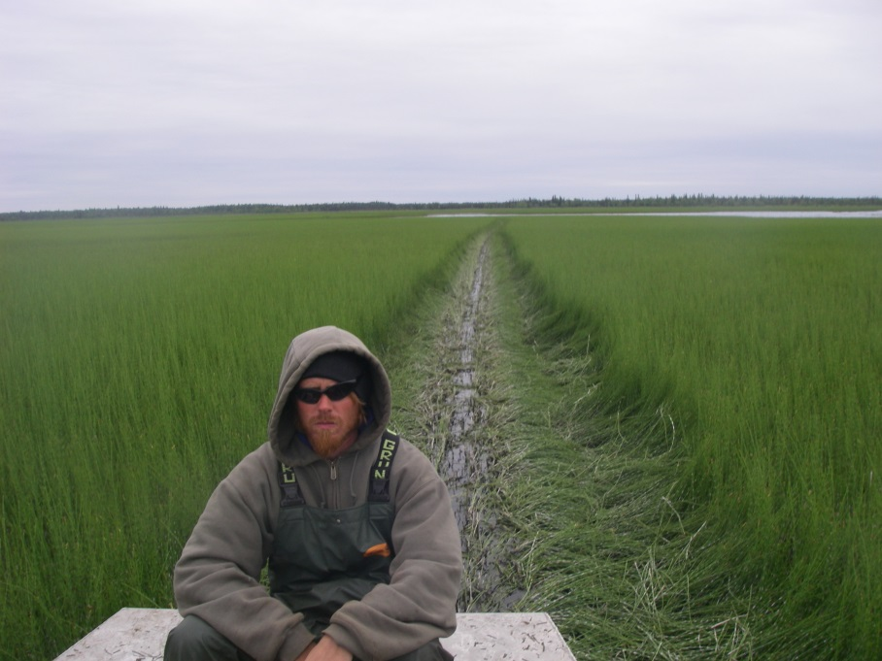
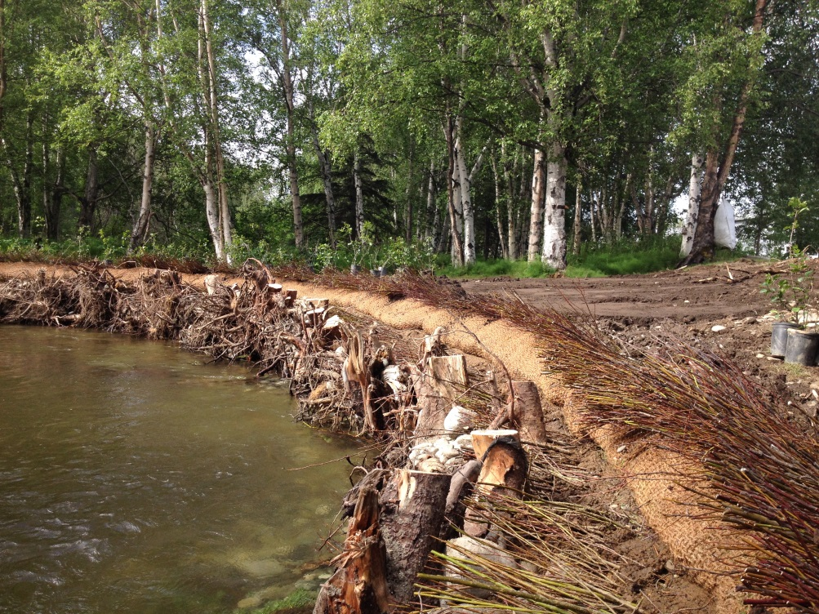
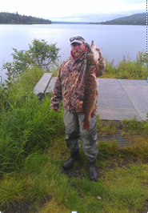
Partnership Progress ~ Restoration:
Symposium Planning
Detection, education, eradication & containment of invasive aquatic species
14 barrier removals opened up 49.5 miles of upstream habitat and 857 lake acres.
Notes:
Slide 6: Restoration of degraded habitats: (1min)
Aquatic invasives
•Aquatic invasive plant Elodea was discovered in remote Alexander Lake west of the Susitna in 2014. Partners have also been doing detection surveys and education on highest risk waterbodies to prevent further spread. The goal for elodea is eradication with treatment planned for summer 2016. (DNR , CIAA, PSWCD, TTCD )
•With invasive pike that are widespread and well established the goal is containment. Alexander Creek watershed, formerly a premier chinook fishery is a focus area where ADF&G is working on pike containment and localized eradication. With each year of pike suppression, chinook fry are being found further up the stream system.
Fish passage
Fish passage continues to be a big focus of the Partnership. 290 barriers to fish passage remain in Mat-Su that likely prevent or limit salmon from reaching spawning or nursery grounds. 63 of these barriers account for 75% of the total miles upstream of them. This new information will help partners further prioritize culverts for replacement.

Slide 7
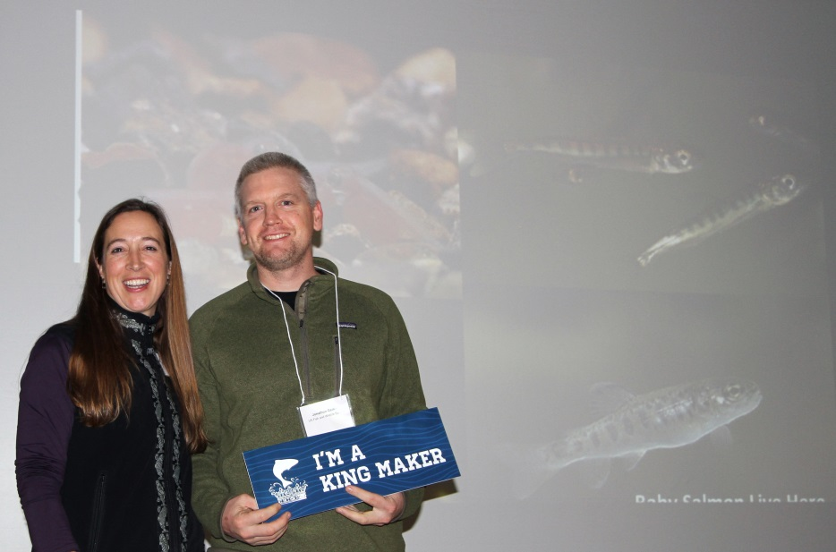
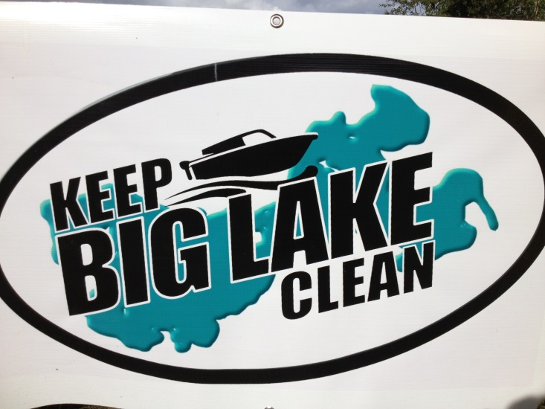
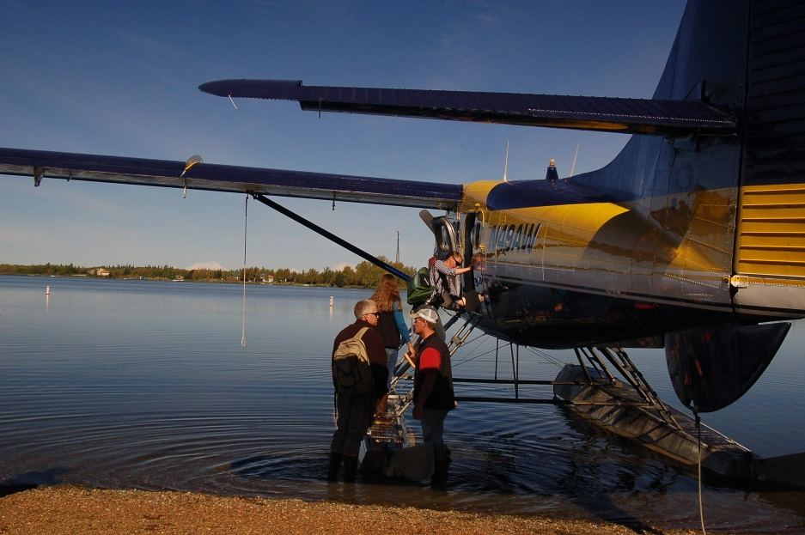
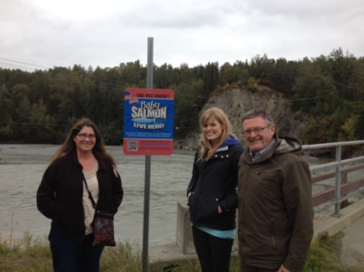
Partnership Progress ~
Information Sharing & Education:
aldjfkdfjldfkjldkf
Partnership:
Annual Mat-Su Salmon Symposium
Summer Site Tour
Wildlife Wednesday
Partner campaigns & initiatives:
Clean Boating
Kingmakers
Septic Smart
Baby Salmon Live Here
Susitna Salmon Center
Salmon in the Classroom
Notes:
Slide 7: Bringing people together is an important role of the partnership.
The annual salmon symposium continues to be our premier outreach event and AGM for the partnership. In it’s 8th year, it’s a wonderful opportunity to network with a range of people, and exchange information on latest salmon habitat efforts in the Mat-Su.
For the first time last summer we partnered with CIAA, and took community leaders on a summer site tour of partner projects around Big Lake and flew out to Shell Lake. It was a great way to give exposure to what partners are doing and why it matters. This will likely be an annual/or bi-annual event and is an exciting complement to the symposium.
We are also Partnering with ADF&G, Alaskans for Palmer Hay Flats & TNC on a monthly Wildlife Wednesdays lecture series about Mat-Su fish and wildlife.
Upcoming events – wildlife wed talk March 2nd(Jon G), site tour (spring/summer – stay tuned), Symposium (november) – always welcome at SC meetings (2nd tues month in palmer ADF&G office).
Listed also on this slide are also some excellent outreach campaigns of our many partners!

Slide 8
Moving forward …
Notes:
So just as Salmon – including Mat-Su Salmon work hard for us, the Partnership is doing the same. (1:30 min)
Some priorities in 2016 will include:
Index watersheds –FHP Science and Data Committee has been reinvigorated and is working to identify representative index watersheds that will be used for focused study, and to detect both change within these individual index watersheds, and across the basin as a whole over time.
Riparian buffers –Partners will be working to establish Mat-Su Borough riparian protection guidelines for the most rapidly developing areas. right now the Borough has limited riparian protections.
Work to stay ahead of the curve as much as we can with invasive species.

Slide 9
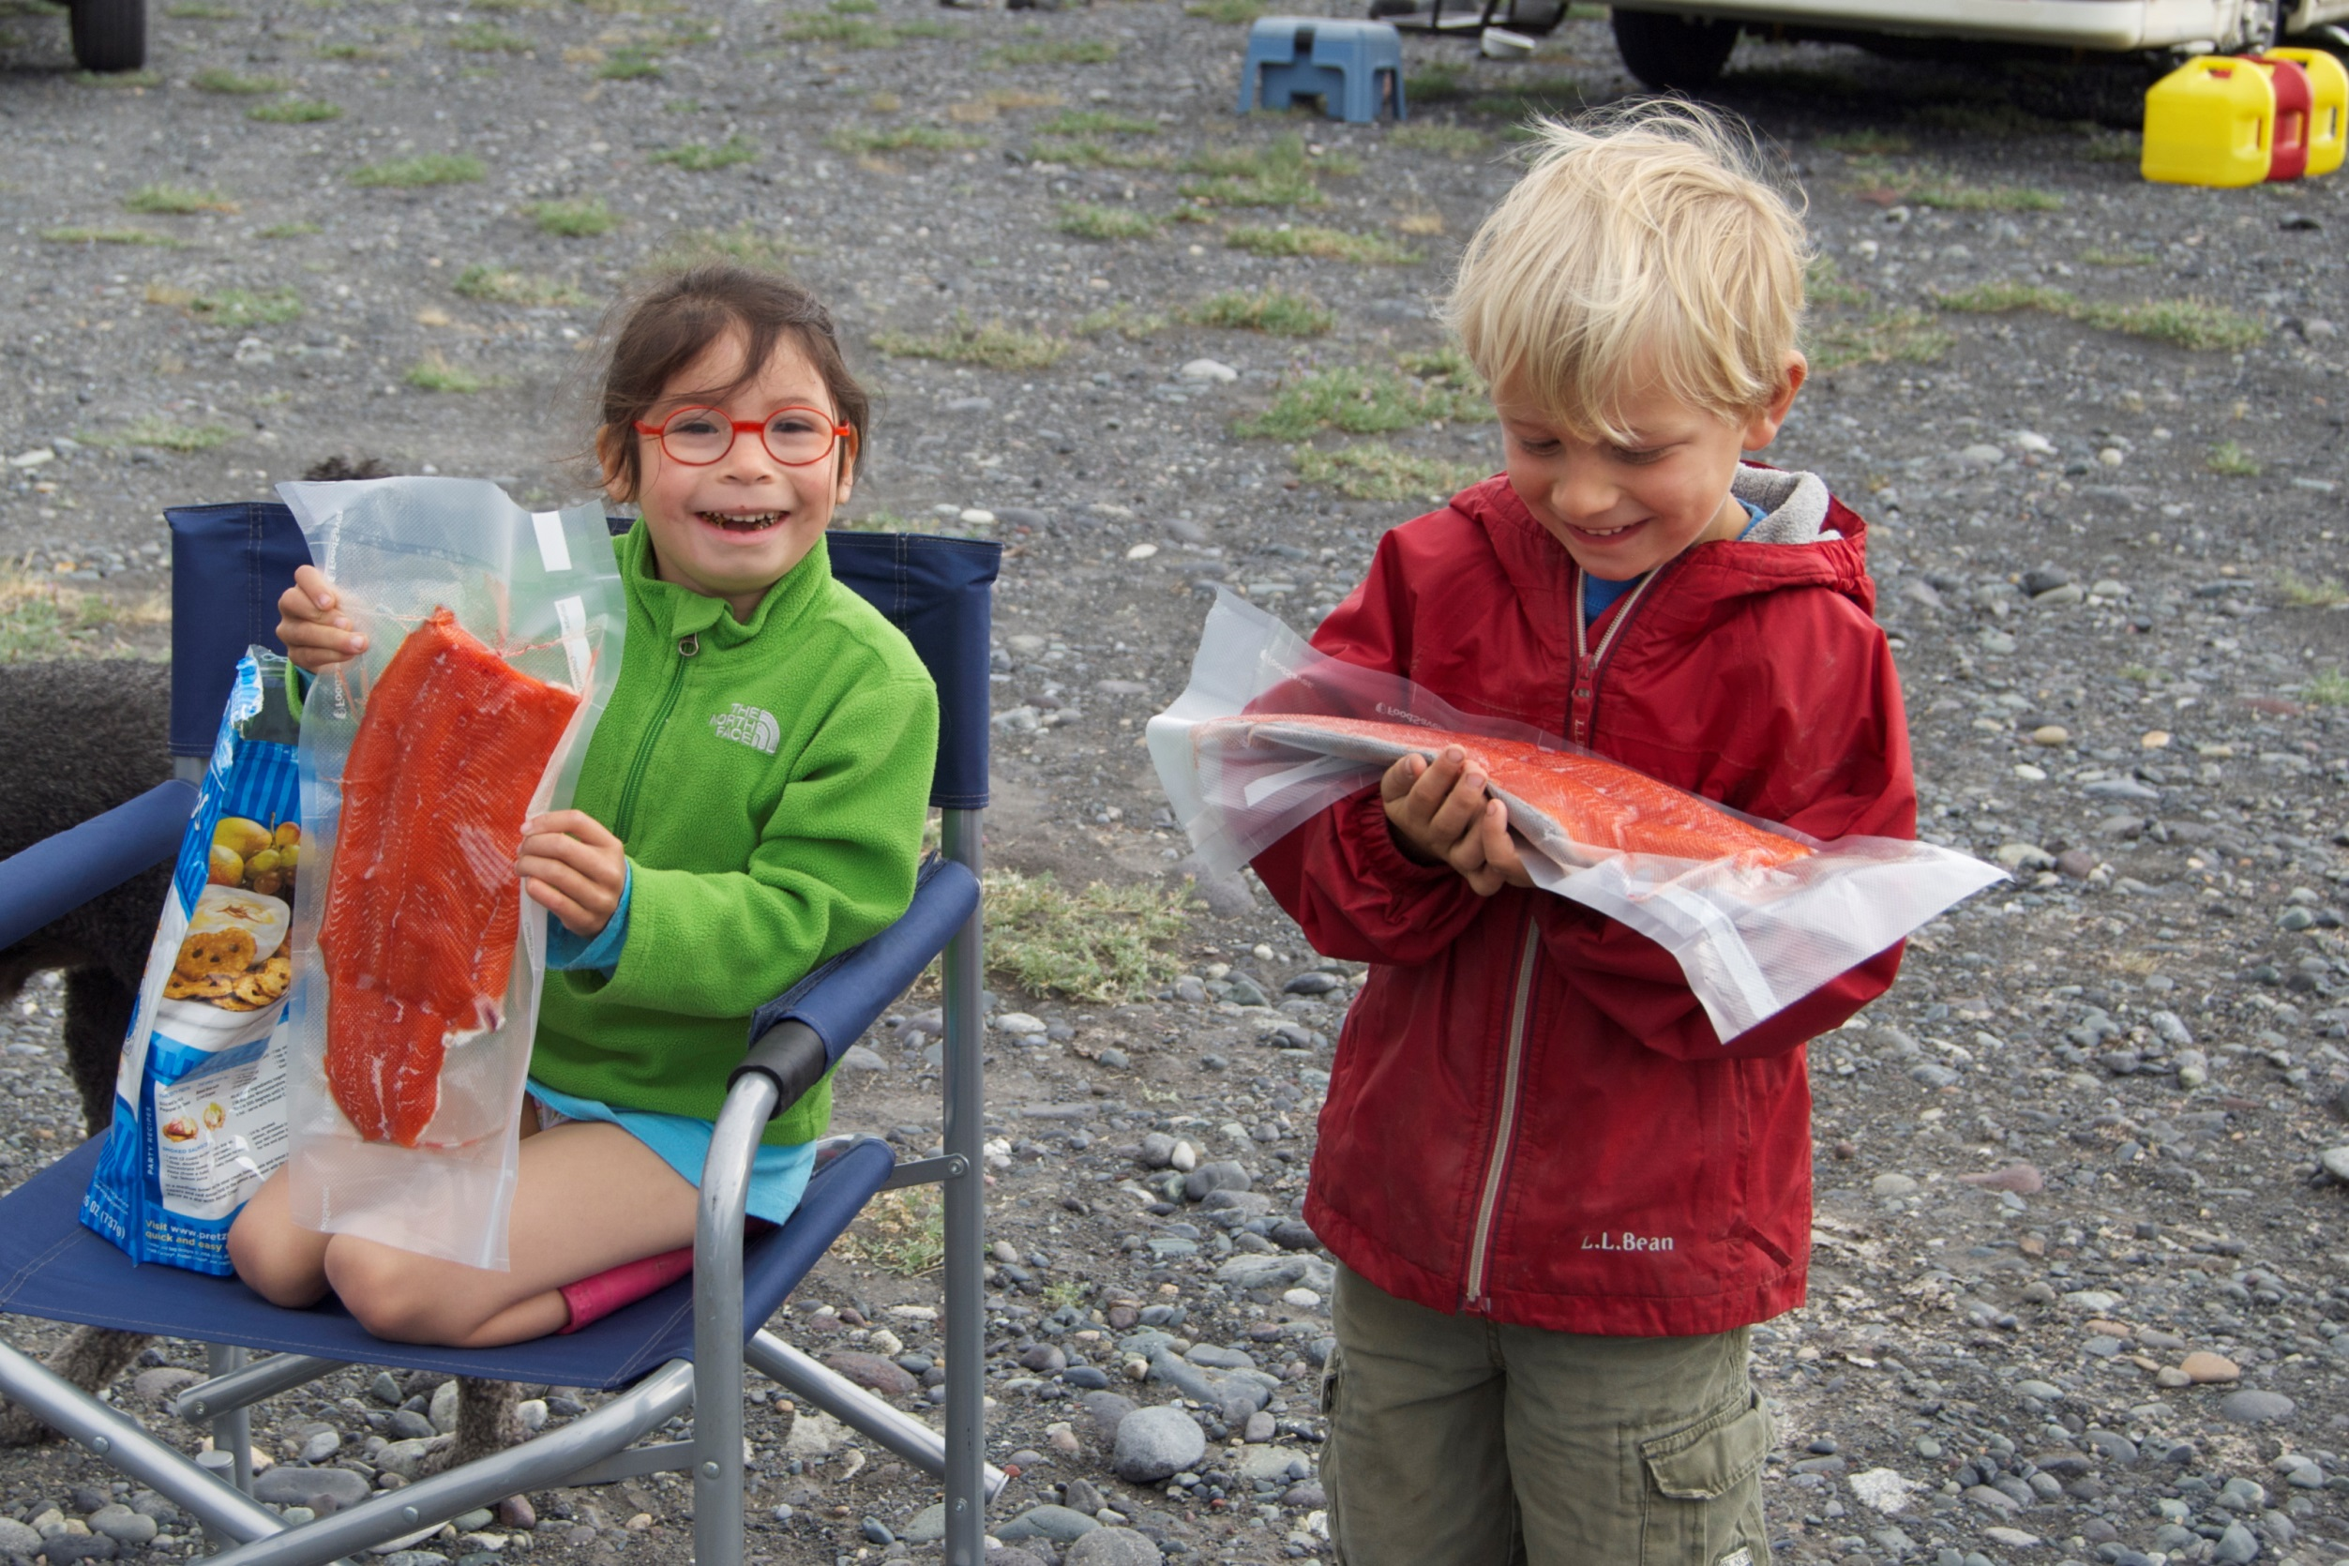
Thank you!
jspeed@tnc.org
865-5713
www.matsusalmon.org
Notes:
Slide 8: Conclusion: (25 sec)
So although a very quick overview, there is great work being done by partners and progress working toward goals of our strategic plan.
Our partnership and salmon habitat conservation in the Mat-Su is strong because of the competence and involvement of our partners. We are incredibly grateful for NFHP funding, and our regional coordinators from FWS, ADF&G and NOAA. In particular to FWS and ADF&G, thank you for the critical staff support! Your field staff are involved with the partnerships on so many levels – science input, steering and sub committees, outreach assistance, symposium, site tour,.. and much more – not to mention so much of the strategic on-the-ground work that moves us forward. You are crucial to our success.
With more challenging fiscal times ahead I do hope agencies are able to continue engaging with FHP’s, and that you see us as a resource to meet overlapping goals, and perhaps salmon conservation goals you can’t acheive alone.
Thank you!

