Slide 1
Mat-Su Fish & Wildlife Commission
An opportunity to collaborate to benefit fisheries & wildlife in the Mat-Su – SALMON SYMPOSIUM UPDATE

Slide 2
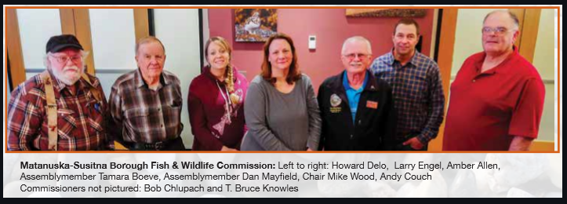
What is the MSB FWC?
Started in 2007: “Mayor’s blue ribbon commission”
8-member commissionAdvocates for fish and wildlife
Stay appraised of FWC activities:
Visit our web page: https://www.matsugov.us/boards/fishcommission
Visit our “fish hub”: https://www.matsugov.us/fishhub
Next meeting: Thursday, Nov. 17, 4 PM…

Slide 3
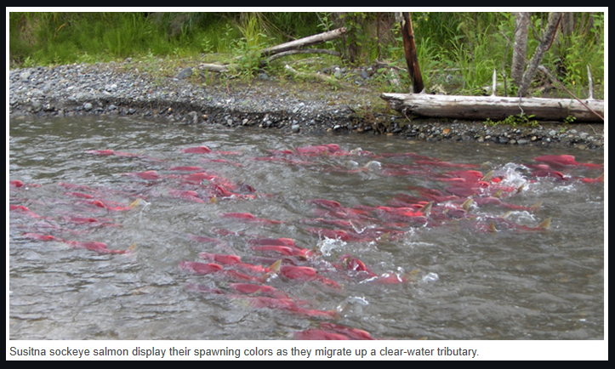
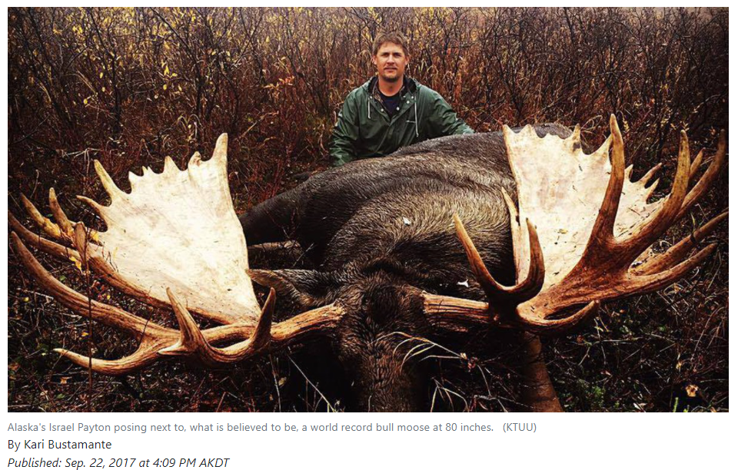
What’s at stake in our work?
The Mat-Su has been famous for it’s King and Coho Salmon runs…
Fishing is important to us – sustenance for the mind and the body.
Salmon habitat and moose habitat overlap…

Slide 4
SOA Water Reservation System
Special FWC meeting June 2022 on this topic.
Short public comment period concern.
Reserving adequate water in changing climate

Slide 5
West Susitna Access Road
FWC wants development that is compatible with safeguarding fisheries habitat

Slide 6
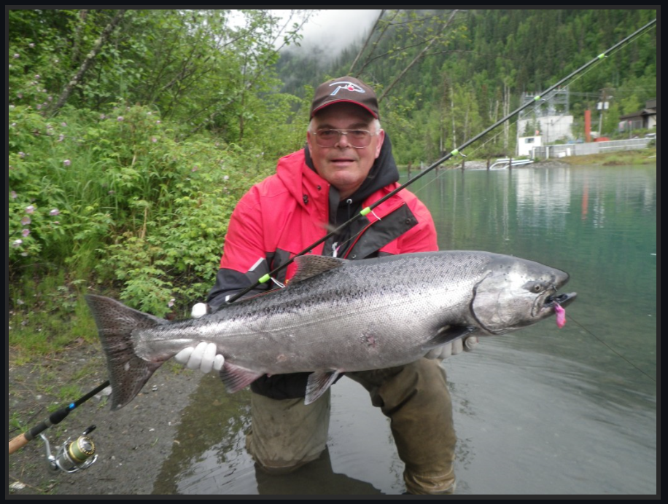
MEA Transmission Line Impacts
An example of how the FWC engages with the public to address fish and wildlife concerns

Slide 7
Future Work
December 7: ADF&G Fisheries Summary Meeting
Susitna Basin Recreation Rivers Plan Update
NPFMC Cook Inlet Commercial Fishing
Board of Fisheries 2024

Slide 8
A better future together?
Let’s work together to make the Mat-Su a fishing destination for all

